Slide 1
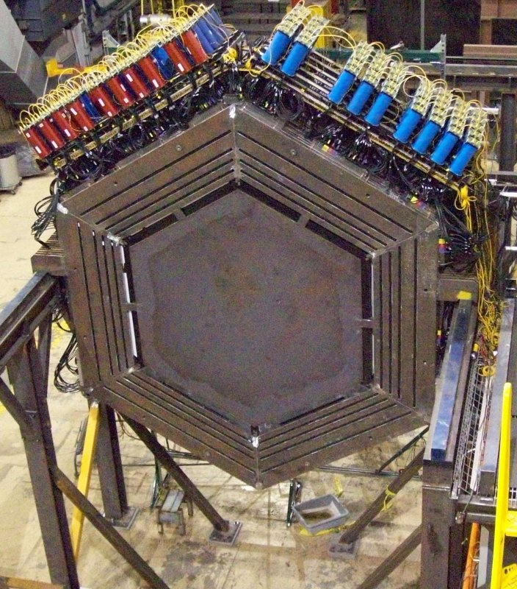
MINERvA
Main INjector ExpeRiment for ν-A
Make sure to pay attention and/or take good notes! There will be a short quiz at the end!
ν is the symbol for the neutrino. The beam that is sent to MINERvA is made out of neutrinos. In chemistry, an A stands for the symbol representing the mass number of the atom (the number of protons and neutrons). This symbolizes the different types of atoms found in MINERvA.

Slide 2
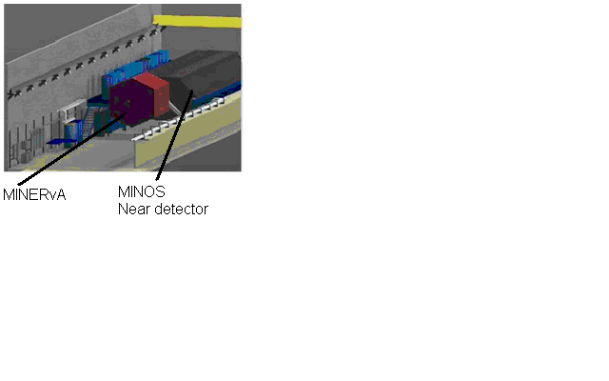
What is MINERvA?
A neutrino scattering experiment
Uses the NuMI (Neutrinos at the Main Injector) beam at Fermi Lab
Seeks to measure low energy neutrino interactions (interactions of protons, muons and pions in particular)
MINERvA sits directly in front of
the MINOS (Main Injector
Neutrino Oscillation Search)
Near detector which
studies high energy particles

Slide 3
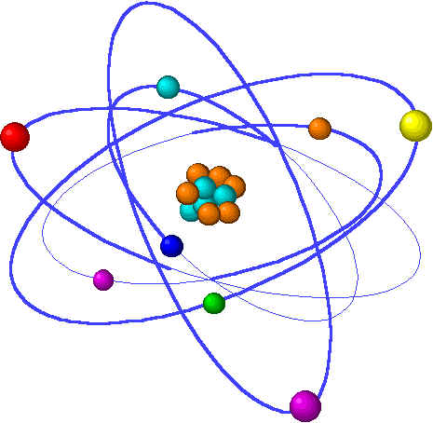
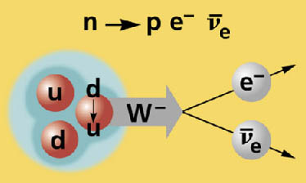
Why Study Neutrinos?
To measure neutrino oscillations
  ν_{e}- electron neutrino; ν_{μ} - muon neutrino; ν_{τ} - tau neutrino
To better understand the nucleus
of the atom
To better understand nuclear
decay
To better understand how neutrinos interact

Slide 4
What Will MINERvA Teach Us?
We need a way to observe particle interactions and their products. We need:
  A record of the track they took.
  To know how much total energy was left in the detector?
  What time did the particle and its energy appear in the detector?
This is enough information to separate one particle from another in space and time, and measure the energy and
momentum (and direction)
of everything we can see.

Slide 5
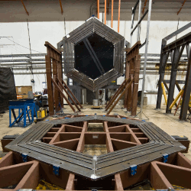
How is MINERvA constructed?
MINERvA is made of many planes of nuclear targets and scintillator material. The nuclear targets are dense materials which offer the particles a large nucleus to interact with. The scintillator material detects particles as they travel through the plane.
Here is one plane of MINERvA being prepared for installation. There are around 200 planes in MINERvA (it changes with every modification). The detector is in the shape of a hexagon. The center of the plane will also be filled with detection material.

Slide 6
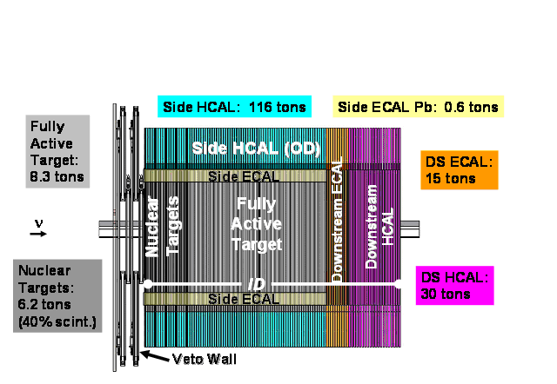
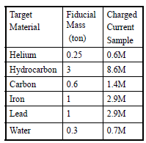
Specialized Areas of MINERvA
Beam enters here
There are three general areas to the MINERvA detector. The fully active target contains lots of scintillator material necessary to detect specific particles. The ECAL contains material for detecting and stopping particles such as electrons and photons. The HCAL is specialized to detect particles and stop pions and protons. You can see that there are both ECAL and HCAL areas in both the sides and back of MINERvA.

Slide 7
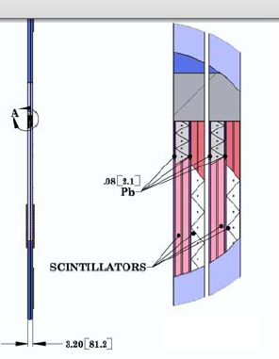
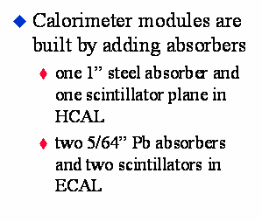
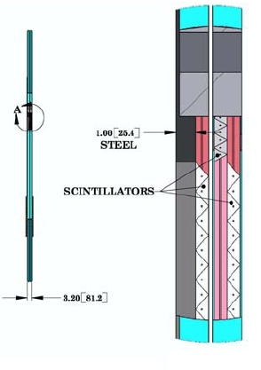
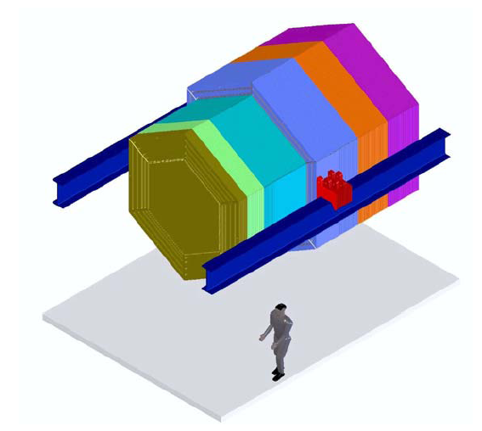
The ECAL and HCAL Modules -The perimeter zone built for stopping particles
HCAL
ECAL
A typical ECAL Module
A typical HCAL Module
The ECAL is located in the outside border of each plane and also in the orange colored portion in the diagram. The HCAL modules are also located in the outer border of the plane and in the purple portion of the diagram.
Notes:
HCAL

Slide 8
The Fully Active Target – The Fiducial Zone
Fiducial = all active detector.
This area of the detector provides the best measurement of tracks and energy because all the information is recorded. This is because of the three layers of scintillator strips.
The back and sides often provide only part of the information! They have fewer scintillator strips per module.
The “Sweet Spot” of the detector!

Slide 9


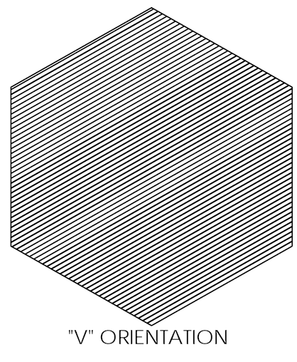

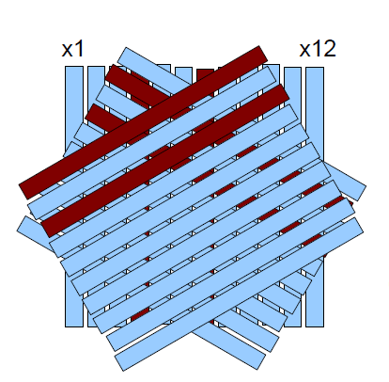
Three Layers of Scintillator Material
There are three different directional layers of triangular polystyrene (clear plastic) scintillator material in the active target. We label these layers X, U and V views. With three layers we can separate the tracks and energy of multiple particles going through the detector at once and “see” precisely where events happened in the detector. Only two layers would leave us with multiple possibilities.

Slide 10
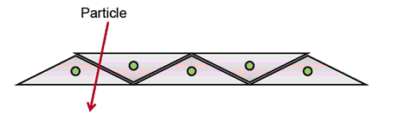

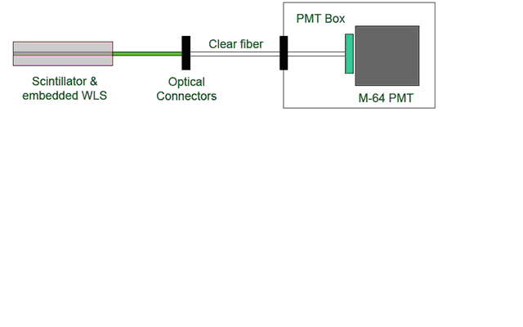
The Scintillator Strips
The Scintillator strips turn the energy deposited by the passing particles into photons (light). This is the structure of the active particle detector layer.
These are small strips which are triangular shaped and are formed in long pieces. These strips turn the energy deposited by the passing particle into photons (light). The wavelength shifting fiber runs through the length of the scintillator and collects the light. The light is then sent to the PMTs.
This shows how the scintillator strips fit together in a panel. Because of their shape, each particle will leave energy in at least two strips. This helps the computers to identify more accurately where the event happened in the detector.

Slide 11
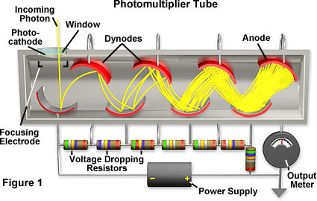
The PMT’s
It’s a photon to electron converter followed by an electron multiplier. A single photon becomes a million electrons!
Incoming photon
10⁶ electrons
Next, the computers analyze the signal and provide us with information about the event.

Slide 12
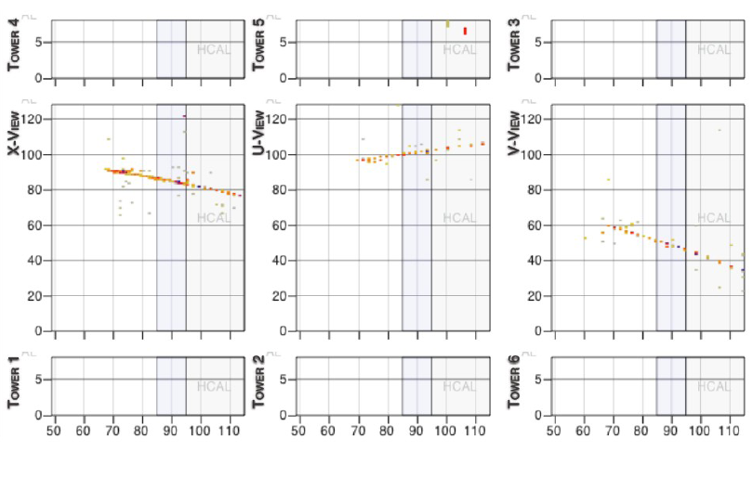
The Data Analysis
This is a sample of one piece of data that the computer provides us. Here you can see the three different views in the X, U and V directions. We will be using this data in our activities.

Slide 13
The Quiz!!
1. What does the MINERvA detector measure?
Number your paper 1 – 8 giving each answer plenty of room – some questions have more than one answer. Yes, there are only 8 questions!!
2. What shape are each of the planes in MINERvA?
3. What is a scintillator strip?
4. What is the shape of a scintillator strip?
5. How many specialized areas are in MINERvA?
6. Name three types of material in MINERvA.
7. What is a wavelength shifting fiber?
8. What does a PMT do?

